Slide 1
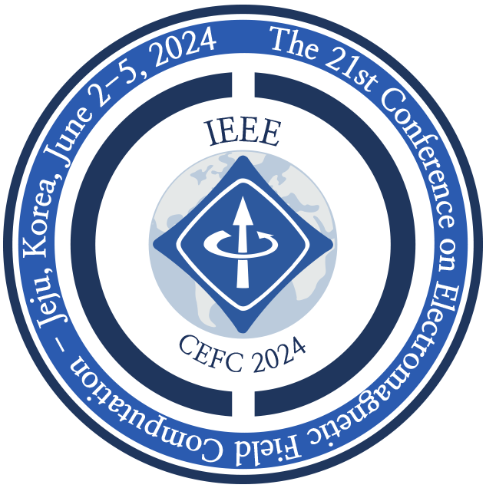
Presentation Code
Presentation Title
Namjoon Jeon¹, Jungkook Kim²
¹Korea University, Korea, ²Yonsei University, Korea

